Slide 1


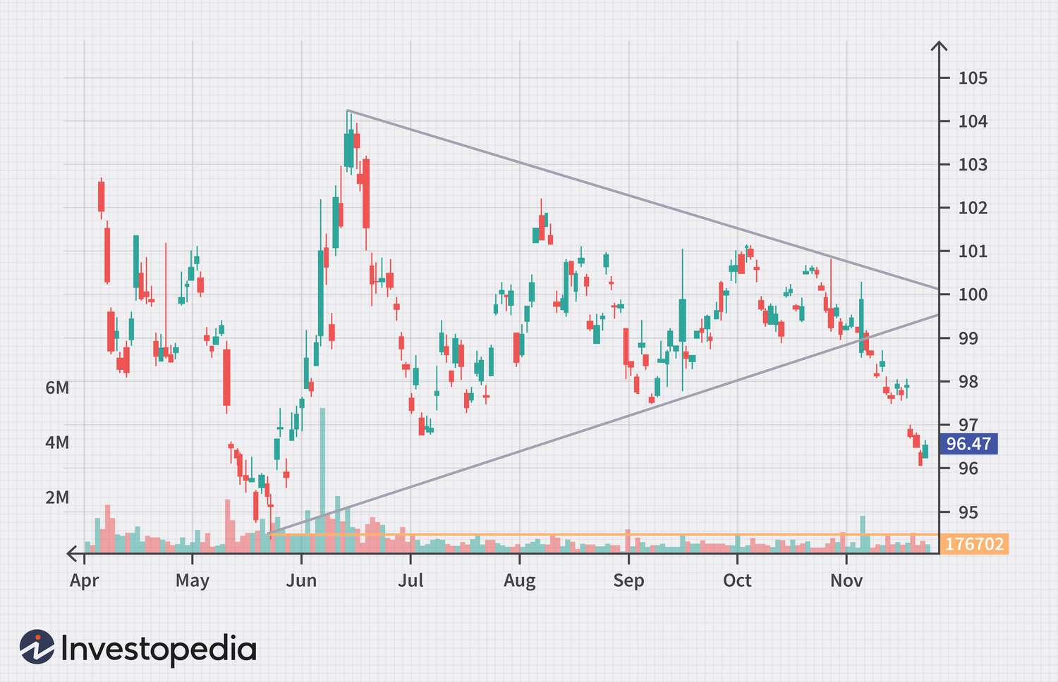
Stock Market Price Forecasting Using Time Series Analysis
Team: Gryffindor

Slide 2
Overview
Data Exploration
Data Pre-processing
Modelling:
  TS Mixer
  SARIMAX
  TIDE
  LSTM
Demo

Slide 3


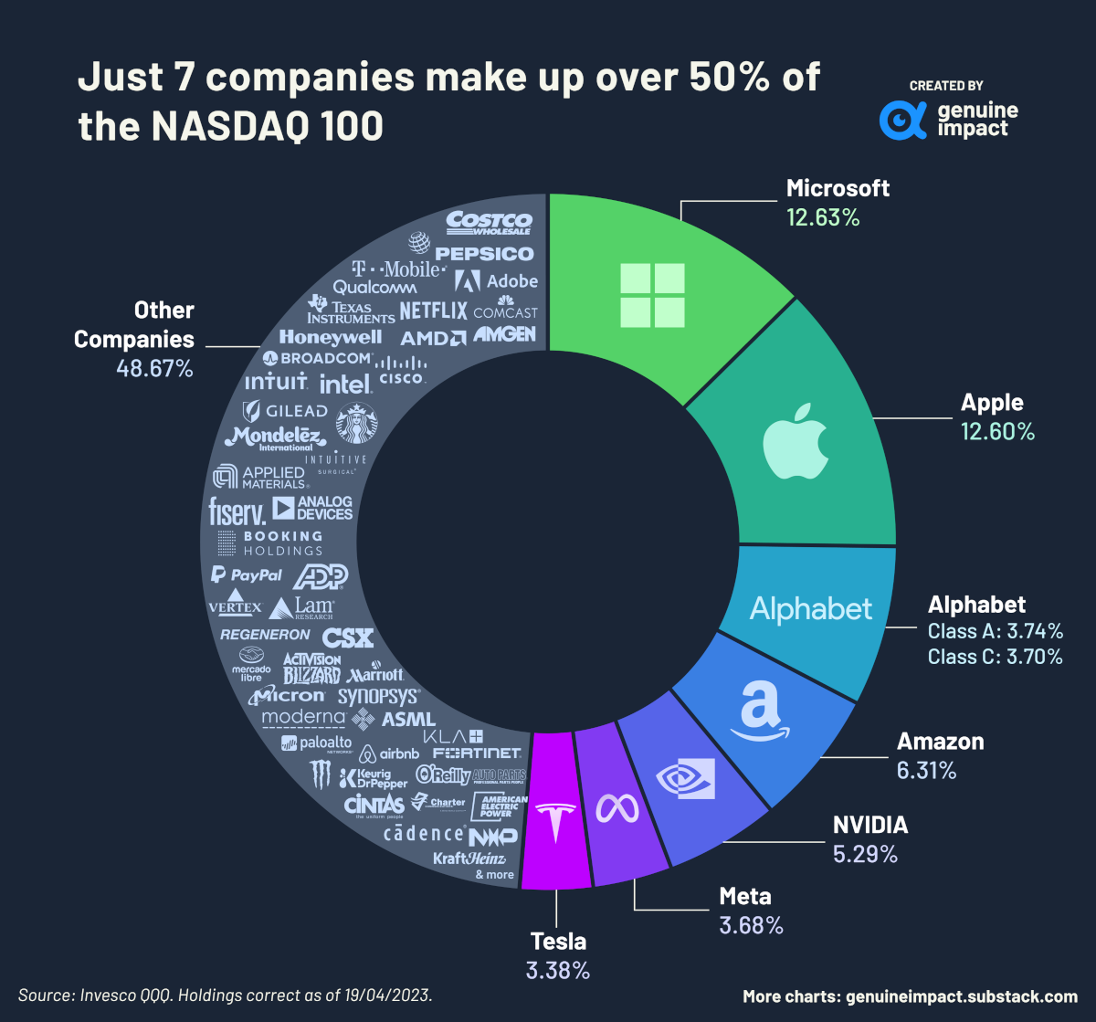
Data Sources

Slide 4
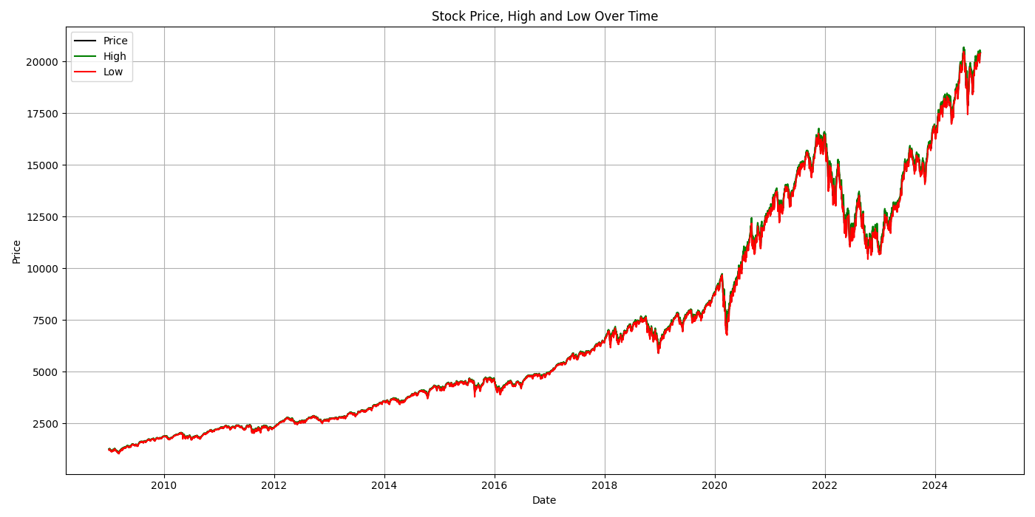
Types
Stock Tickers
Time Series Tabular Data
Market Sentiment Data
Nasdaq 100

Slide 5
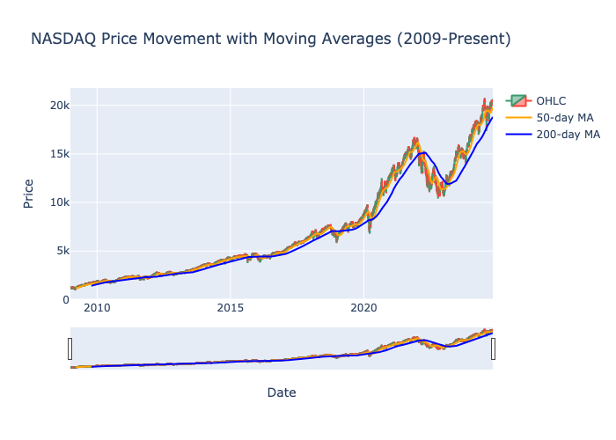
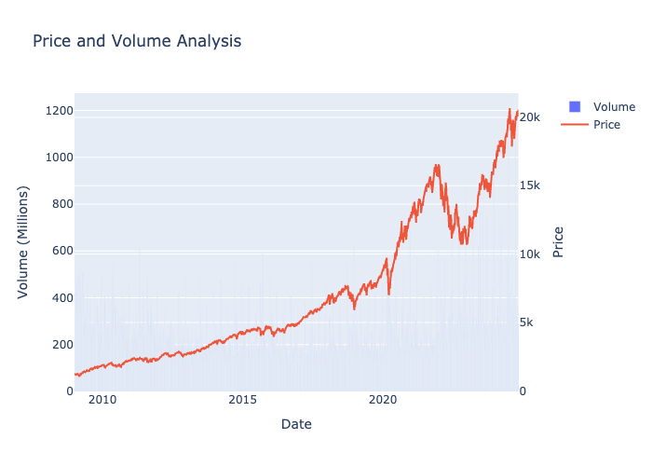
Exploratory Data Analysis

Slide 6
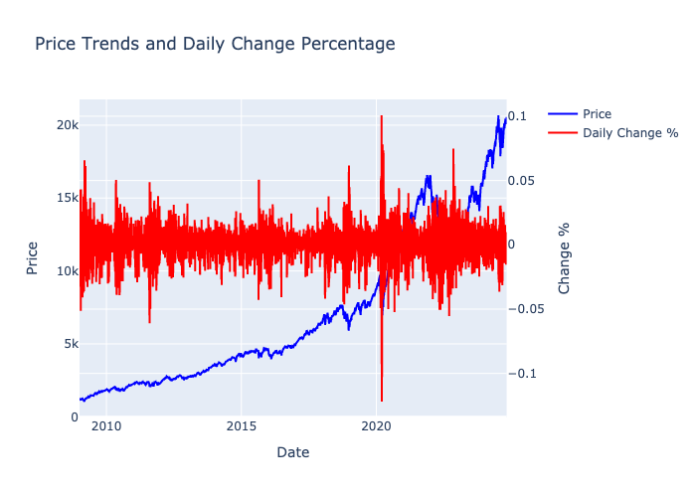
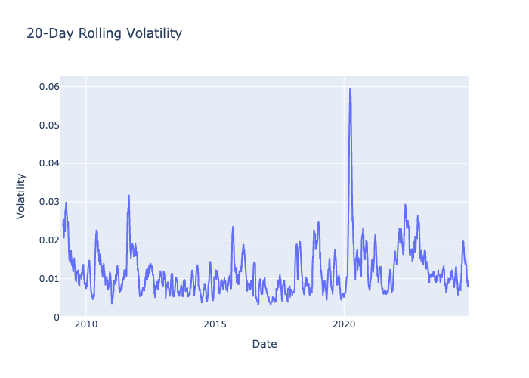
Trends

Slide 7
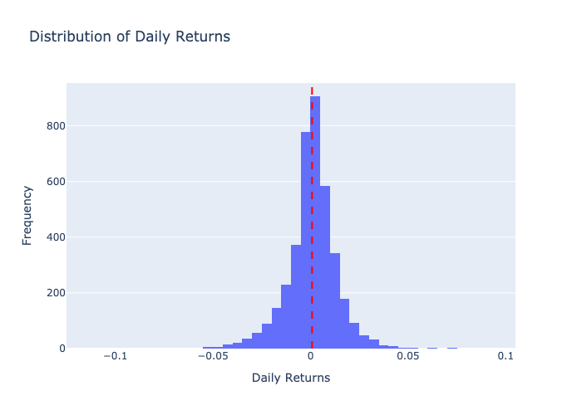
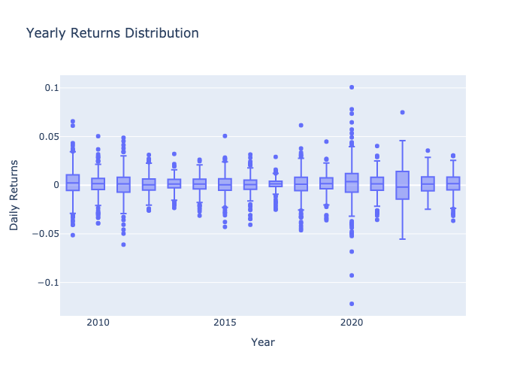
Distributions

Slide 8
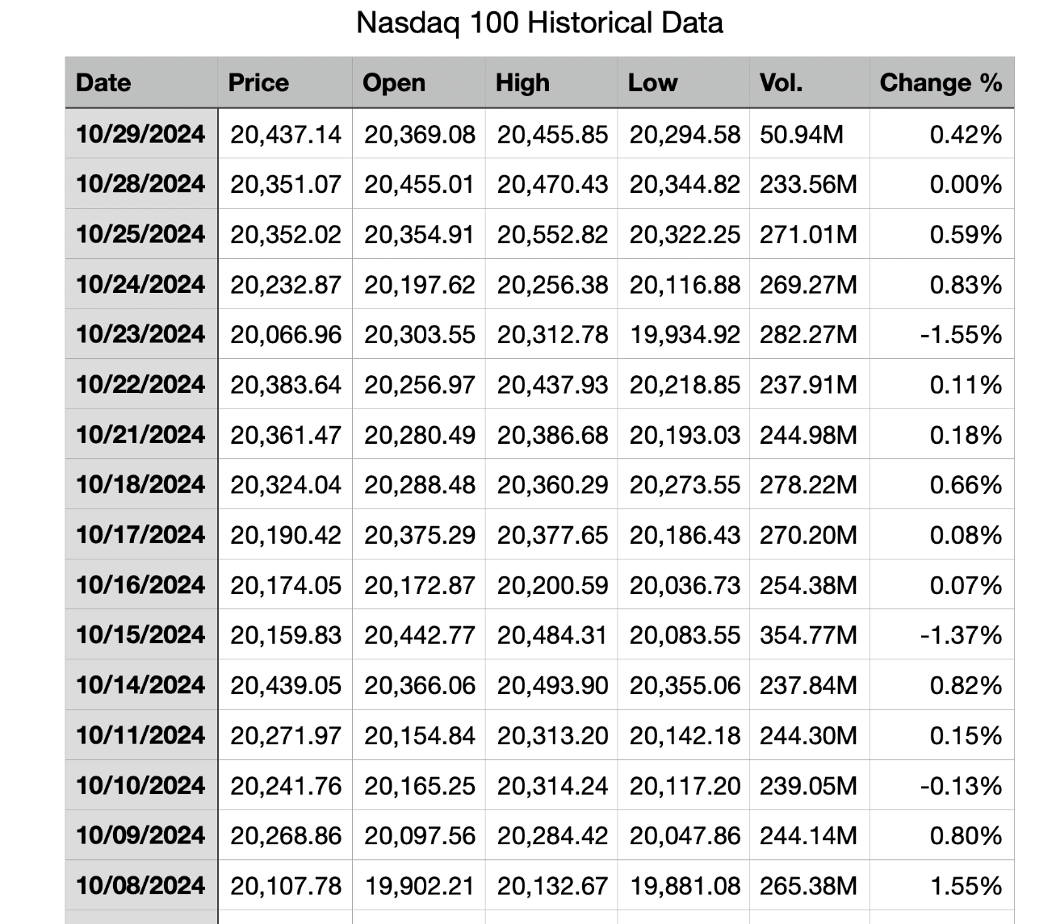
Data Preprocessing

Slide 9
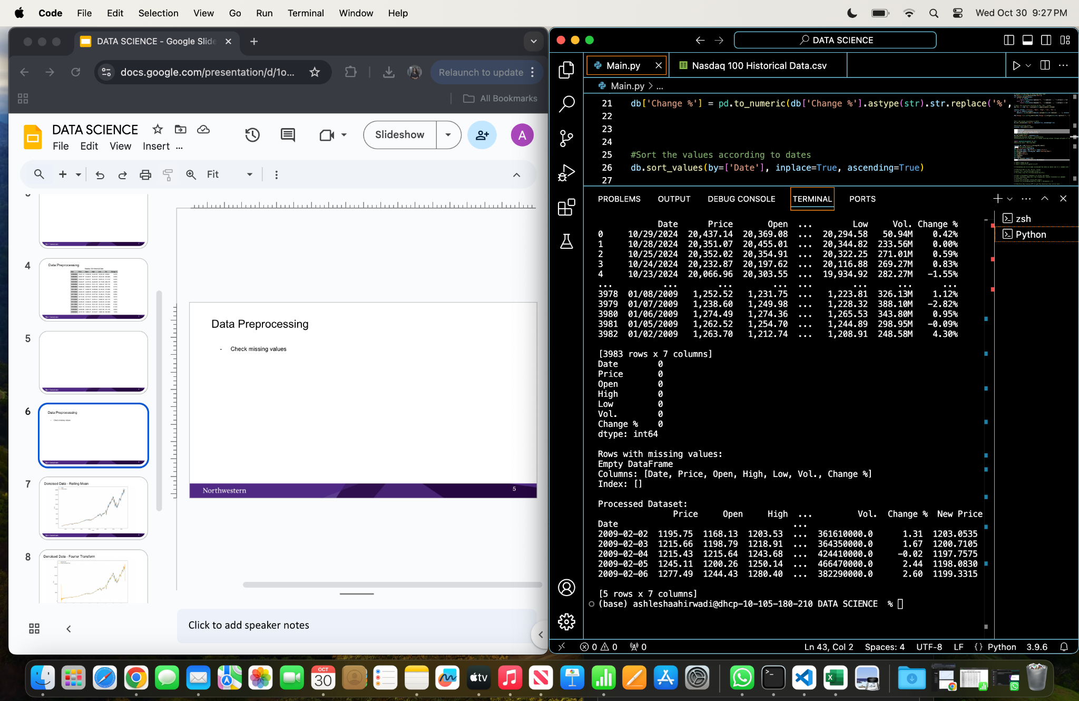
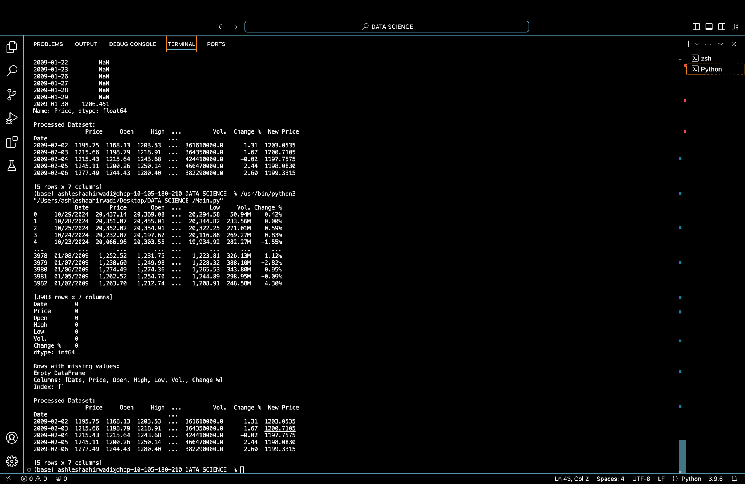
Data Preprocessing
Check missing values
Processed Data

Slide 10
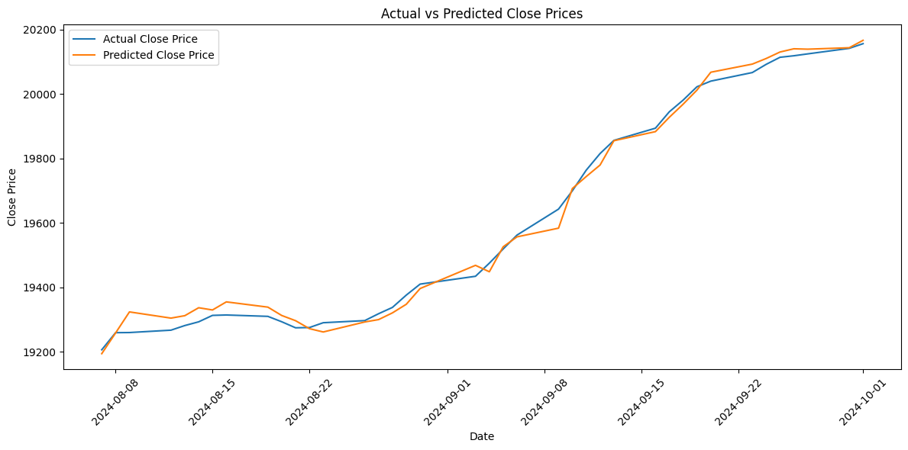
Data Modeling
TS Mixer

Slide 11
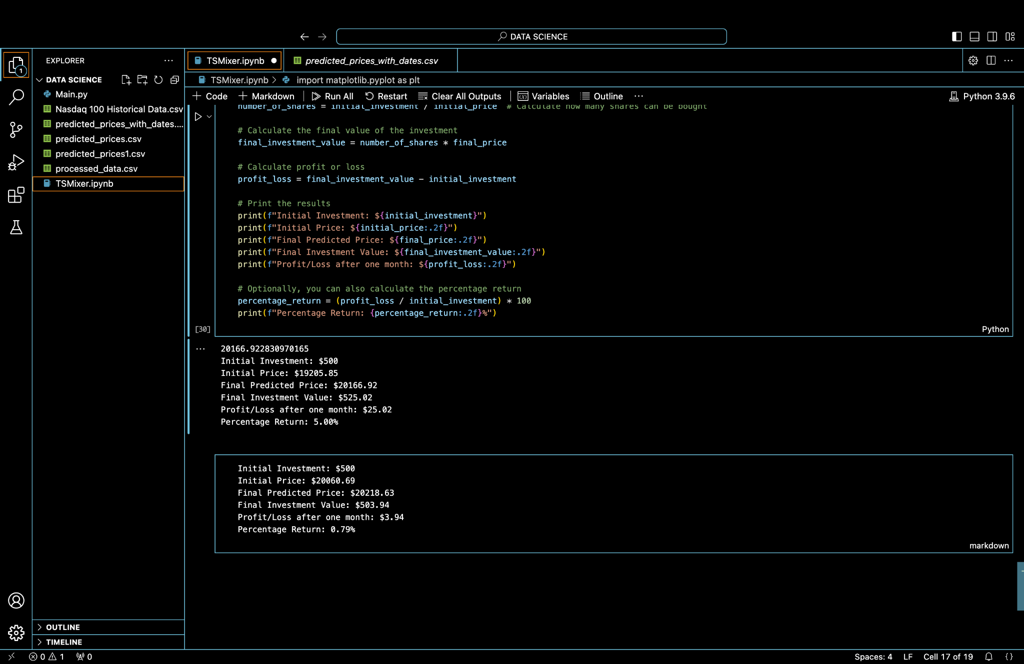
Data Modeling
Mean Squared Error: 648.3022614220741
Mean Absolute Error: 20.8658343965519
Max Error: 64.08125656819539
Predictions with dates saved to predicted_prices_with_dates.csv
Mean Squared Error: 648.3022614220741
Mean Absolute Error: 20.8658343965519
Max Error: 64.08125656819539
Predictions with dates saved to predicted_prices_with_dates.csv
Mean Squared Error: 648.3022614220741
Mean Absolute Error: 20.8658343965519
Max Error: 64.08125656819539
TS Mixer

Slide 12
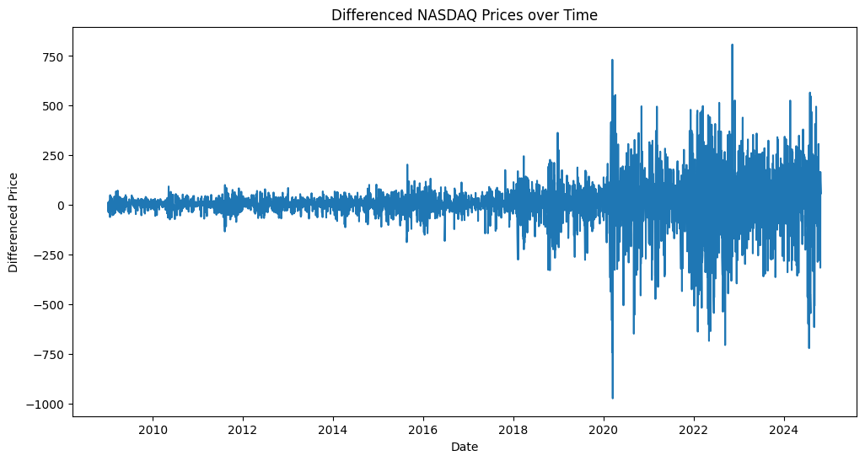
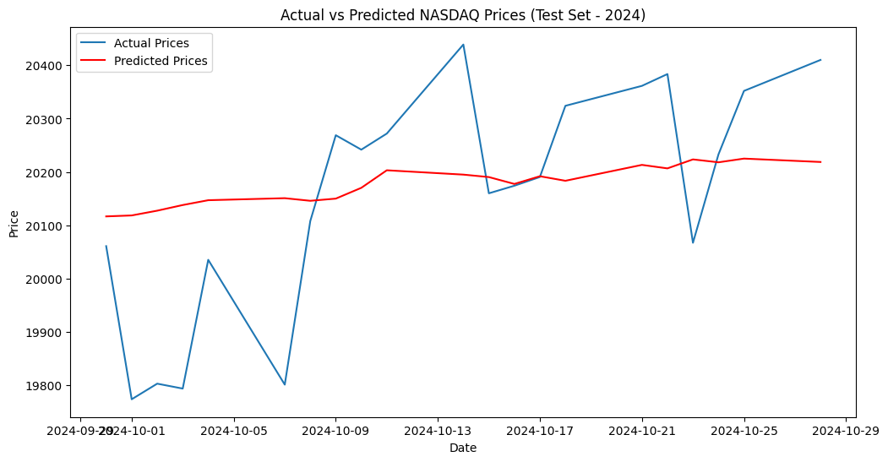
Data Modeling
SARIMAX

Slide 13
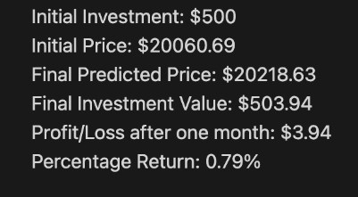
Data Modeling
Validation RMSE: 201.12706581639185
Test RMSE: 184.8865340799536
SARIMAX - Seasonal Autoregressive Integrated Moving Average

Slide 14
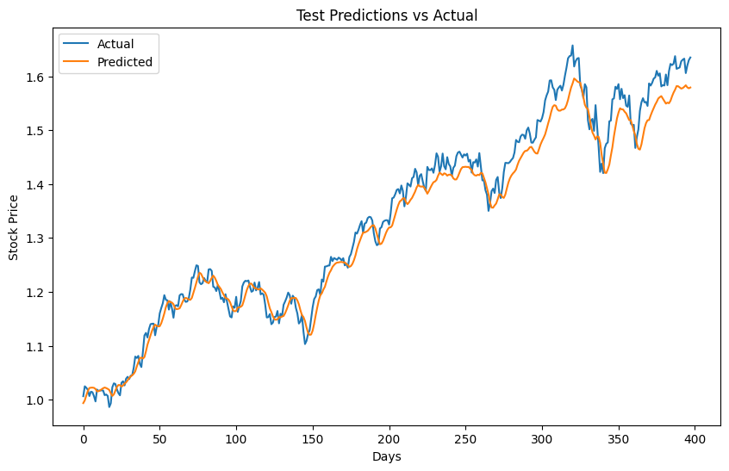
Data Modeling
TIDE

Slide 15
Data Modeling
TIDE
Trial 90 Complete [00h 01m 04s]
val_loss: 0.0011745087103918195
Best val_loss So Far: 0.0005336981266736984
Total elapsed time: 01h 09m 04s
Test MSE: 0.0009702005536890854
Predicted return on $500: $270.77
Actual return on $500: $287.24

Slide 16
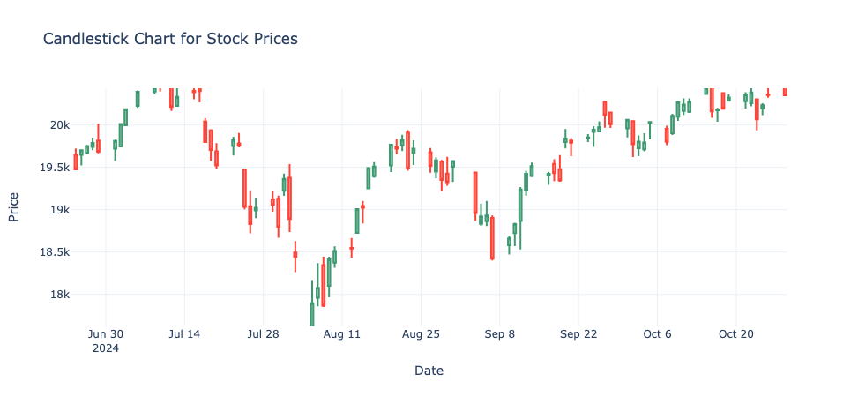
Candlestick

Slide 17
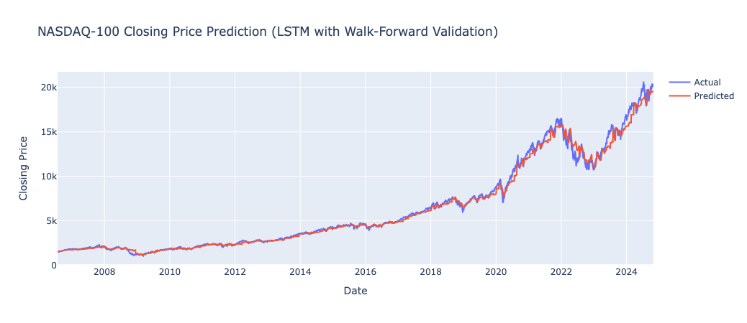
LSTM
MAPE - 3.63%

Slide 18
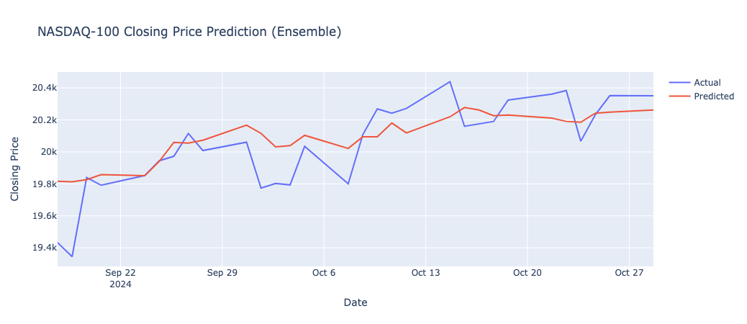
WIP
MAPE < 1%

Slide 19
Conclusion
TS Mixers | Mean Squared Error: 648.30
SARIMAX | Mean Squared Error: 202.12
TIDE | Mean Squared Error: 0.00097
SARIMAX: Good for stable, linear predictions
TIDE: Excellent for accuracy in price predictions
TS MIXER: Best for maximizing investment returns
LSTM: Reliable for long-term pattern recognition

Slide 20
Thank You

